Slide 1
S
Santander
CONFIDENTIAL // MVP2 ARCHITECTURE
XENA MVP2
GRID Architecture
Optimizing GRID CPU Utilization and Parallelism
PREPARED FOR
GRID C++ Engineering Team
03/2026
SLIDE 01

Slide 2
Why We Are Here
Problem Statement — The Scale Challenge
📊
326,897+
⚙
Millions
Total Deals in Production
Monte Carlo Paths per Deal
Across 23+ books. eFX alone holds 48,178 deals (14.73%).
Each deal spawns thousands of simulation paths. Naive parallelism fails at this scale.
📉
~60%
⚠
O(n·book)
Typical CPU Utilisation
Memory Complexity — Polling Model
Book-level parallelism leaves 40% of compute idle due to uneven workload tails.
Redis-based polling causes unbounded memory growth as volume increases.
02 / 18
XENA MVP2 · GRID ARCHITECTURE
CONFIDENTIAL

Slide 3
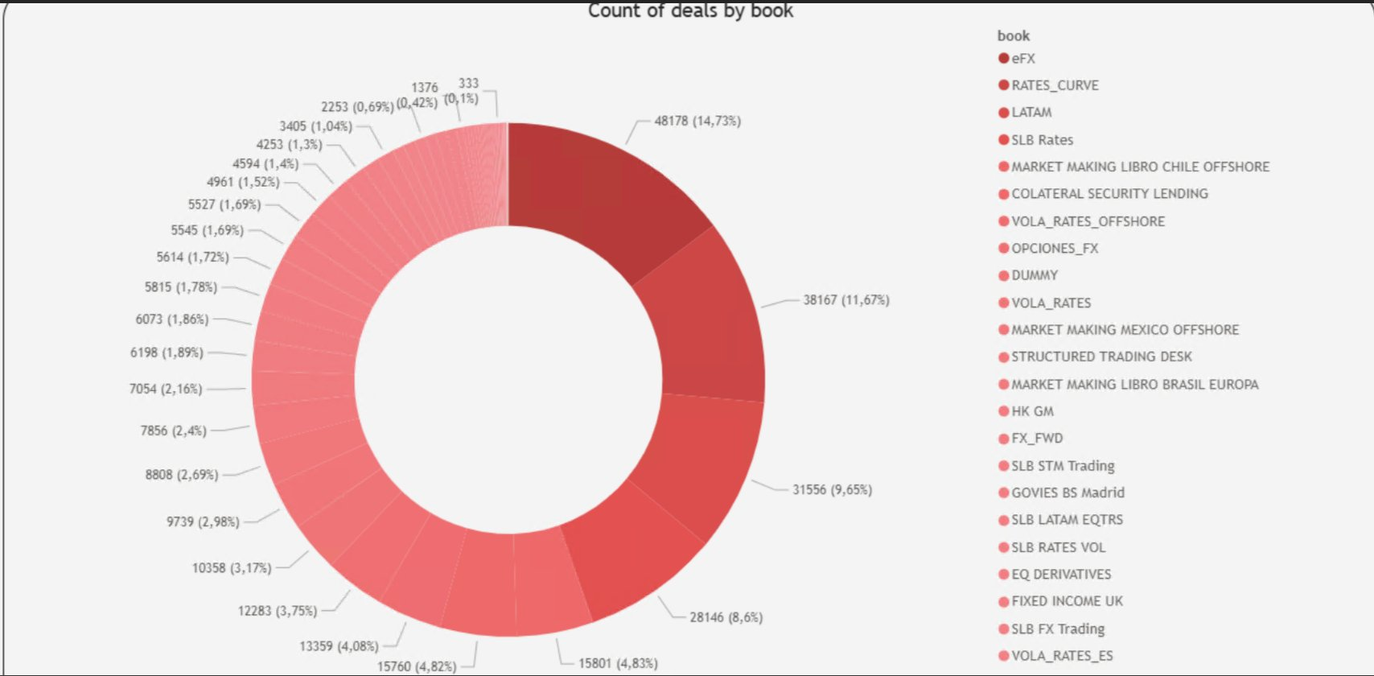
Production Data // 326,897 Deals
S
Deal Distribution by Book
KEY INSIGHTS
48,178
14.73%
eFX — largest book
38,167
11.67%
RATES_CURVE
31,556
9.65%
LATAM book
28,146
8.60%
SLB Rates
Top 4
44.65%
of all deals
23+
books
active in production
326,897
23+
~14,213
48,178
333
Total Active Deals
Trading Books
Avg Deals / Book
Max (eFX)
Min (VOLA_RATES_ES)
SANTANDER · XENA MVP2 · CONFIDENTIAL
03 / 18

Slide 4
Design Objectives
Architecture Goals — What We Optimise For
Target: 800+ deals/min · 95% CPU utilisation · O(1) memory per message
⬆
60% → 95%
N-core scale-out
0 idle cycles
Maximise CPU Utilisation
⚙
Fine-Grained Parallelism
◎
Zero Idle Time
Deal-level parallelism replaces book-level. Every core stays busy.
XDE decomposes each book into individual deal tasks distributed across all cores.
Work-stealing scheduler ensures no core waits. Dynamic queue rebalancing at runtime.
✦
Stateless EKS
< 1% rework
S3 as contract
Minimal Orchestration Overhead
↺
Resilient Resumption
🔒
Immutable Outputs
XENA services remain stateless. Compute state lives exclusively in GRID/XDE.
Reconciliation mode skips already-processed deals. Partial failures cost < 1% rework.
All results written to S3. Reproducible, auditable, decoupled from compute lifecycle.
04 / 18
XENA MVP2 · GRID ARCHITECTURE
CONFIDENTIAL

Slide 5
System Overview
S
High-Level Architecture — Three Layers
01
XENA Services (EKS)
CalibrationService · FMTMService · ProgressTracker · EventEmitter
Control Plane — Orchestration & Job Management
▼
02
GRID Compute Layer
XDE C++ Library · Dynamic Queues · Work Stealing · Deal Decomposition
Parallel Scientific Computation Engine
▼
03
Event & Storage Layer
Amazon S3 · _progress.json · manifest.json · Event-Driven Triggers
Asynchronous Communication & Persistence
Job → XENA (orchestrate) → GRID/XDE (compute) → S3 (persist) → manifest.json → Event (notify)
SANTANDER · XENA MVP2 · CONFIDENTIAL
05 / 18

Slide 6
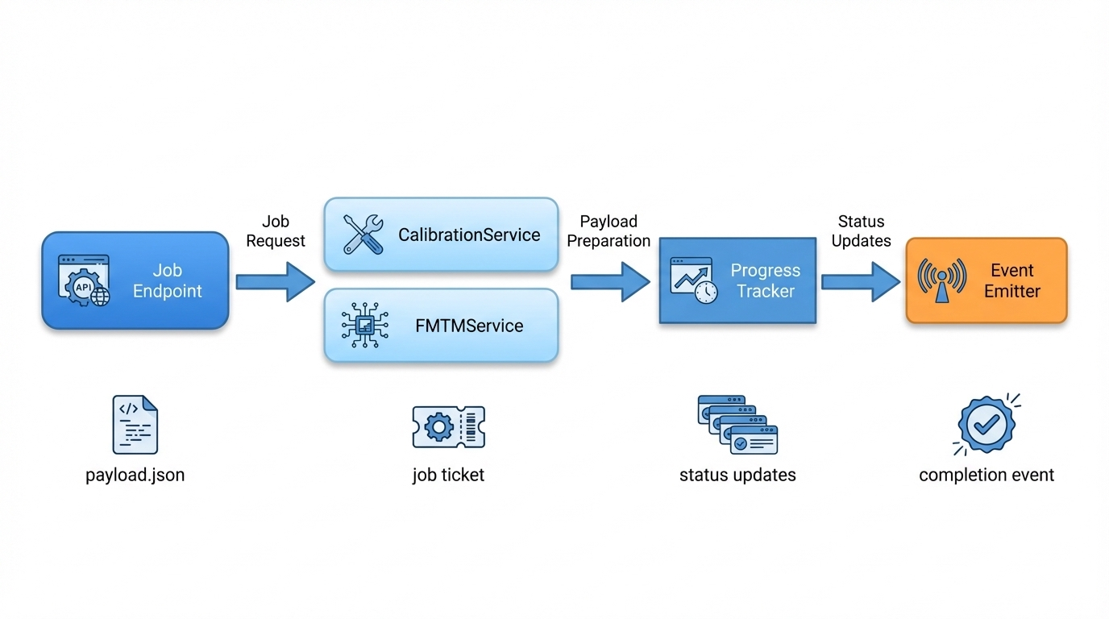
Control Plane — XENA Services (EKS)
XENA Engine — The GRID / XDE Invoker
RESPONSIBILITIES
1
Job Endpoint
Receives payload.json from upstream; validates schema & routes to service.
2
CalibrationService
Prepares calibration GRID payload; no heavy compute executed here.
3
FMTMService
Prepares FMTM GRID payload; translates risk job into XDE task spec.
4
ProgressTracker
Reads _progress.json from S3; tracks deal-level completion without coupling to compute.
5
Event Emitter
Fires completion event when manifest.json signals 100% deals processed.
Heavy compute is NEVER executed in XENA services.
06 / 18
XENA MVP2 · GRID ARCHITECTURE
CONFIDENTIAL

Slide 7
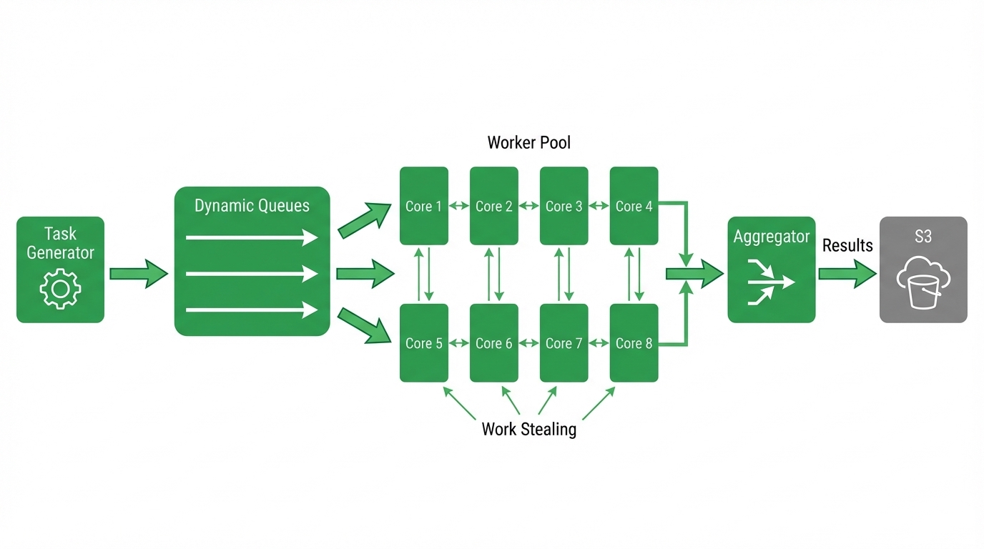
Compute Plane // XDE C++ Library
S
GRID + XDE — Parallel Compute Engine
XDE COMPONENTS
⚙
Task Generator
Decomposes each book into individual deal-level tasks fed into dynamic queues.
≡
Dynamic Queues
Work items distributed across N queues — one per logical thread group.
▣
Worker Pool (8 cores)
Core 1–8 shown. Scales to full node capacity. Each core pulls independently.
↗
Work Stealing
Idle cores steal tasks from busy queues. Eliminates tail-latency stalls.
∑
Aggregator
Collects partial results asynchronously. Non-blocking write pipeline.
☁
S3 Output
Writes immutable result objects. manifest.json signals job completion.
SANTANDER · XENA MVP2 · CONFIDENTIAL
07 / 18

Slide 8
CPU Utilisation — Mathematical Proof
Why CPU Approaches 100% — The Queue Model
FORMAL MODEL
HETEROGENEOUS DEAL COST — SOLVED AUTOMATICALLY
BOOK
= orchestration unit (dispatched by XENA)
Deal A
0.5s
DEAL
= atomic compute unit (executed by XDE)
Deal B
15s
N
= worker threads (= hardware cores)
M
= total deals in book
Deal C
1s
Dynamic queue → fast threads immediately take next work
→ automatic load balancing, no manual partitioning
// XDE worker loop — runs on each of N cores
while (GlobalDealQueue.pop(deal)) {
process(deal); // CPU bound
}
// Queue exhausted → brief idle → job done
DYNAMIC BATCH SIZE — PREVENTS TAIL PROBLEM
size_t computeBatchSize() {
size_t remaining =
totalDeals - processedDeals;
if (remaining > 20000) return 200;
if (remaining > 5000) return 50;
if (remaining > 1000) return 10;
return 1; // Fine-grained at tail
}
THEOREM
CPU utilisation ≈ 100% until queue empty
Idle time occurs only at the very end (tail)
08 / 18
XENA MVP2 · GRID ARCHITECTURE
CONFIDENTIAL

Slide 9
Performance Engineering
S
CPU Utilisation Strategy — Before vs After
✕ BEFORE — Book-Level Parallelism
✓ AFTER — Deal-Level Parallelism (XDE)
~60%
~95%
Average CPU Utilisation
Average CPU Utilisation
C1 BUSY
C2 BUSY
C3 BUSY
C4 BUSY
C1 95%
C2 95%
C3 95%
C4 95%
C5 BUSY
C6 IDLE
C7 IDLE
C8 IDLE
C5 95%
C6 95%
C7 95%
C8 95%
40% of cores idle, waiting for slowest book in batch
Work stealing keeps all cores busy — no idle wait on tail tasks
▲ +35pp CPU GAIN
60% → 95% utilisation
SANTANDER · XENA MVP2 · CONFIDENTIAL
09 / 18

Slide 10
Parallel Compute — The Hard Problem
Tail Latency & Work-Stealing Solution
THE PROBLEM
THE SOLUTION — WORK STEALING
Without Work Stealing — 4 cores idle, waiting on Core 4 tail task
With Work Stealing — idle cores steal sub-tasks from tail
Core 1
T_normal
DONE
Core 1
DONE
Core 2
DONE
Core 2
DONE
Core 3
DONE
Core 3
DONE
Core 4
TAIL ← BOTTLENECK
Core 4
TASK SPLIT
Core 5
IDLE
Core 5
STOLEN ↑
Core 6
IDLE
Core 6
STOLEN ↑
Core 7
IDLE
Core 7
STOLEN ↑
Core 8
IDLE
Core 8
STOLEN ↑
Tail Reduction
Throughput Gain
~60%
+58%
10 / 18
XENA MVP2 · GRID ARCHITECTURE
CONFIDENTIAL

Slide 11
Data Ingestion Model — GRIDConnector
Payload Delivery — Job Initialisation Contract
GRID CONNECTOR PAYLOAD — payload.json
FIELD PURPOSE
{
"jobId": "uuid",
"bookId": "ABC123",
"valuationDate": "2026-03-07",
"inputFile": "s3://xena-input-{env}/{bookId}/book.parquet",
"resultsPath": "s3://xena-output-{env}/{bookId}/",
"errorPath": "s3://xena-error-{env}/{bookId}/",
"totalDeals": 825734,
"bookSizeBytes": 4387239842,
"reconciliation": false,
"bookRetries": 0,
"etaSeconds": 180
}
totalDeals
Initialize progress tracking
bookSizeBytes
Monitoring + scheduling
reconciliation
Partial recompute mode
bookRetries
Reconciliation attempts
etaSeconds
Observability & alerting
WHY THIS MATTERS
✓
Avoids duplicate metadata reads — all state known at start
✓
Enables faster startup — no S3 scan at init
✓
Deterministic initialisation — reproducible runs
✓
Dynamic observability — ETA + progress from first moment
11 / 18
XENA MVP2 · GRID ARCHITECTURE
CONFIDENTIAL

Slide 12
Observability & Monitoring — XDE writes _progress.json
S
Progress Tracking
_progress.json — periodic checkpoint
LIVE DERIVED METRICS
{
"bookId": "eFX",
"inputFile": "s3://xena-input/eFX/book.parquet",
"totalDeals": 48178,
"processedDeals": 17842,
"completedDeals": 17000,
"failedDeals": 842,
"lastProcessingDeal": "deal-918273",
"processingRateDealsPerSec": 145,
"estimatedCompletionSeconds": 210,
"bookRetries": 1,
"startTime": "2026-03-05T18:00:12Z",
"lastUpdate": "2026-03-05T18:42:11Z",
"gridJobId": "grid-742912",
"version": "1.0"
}
Progress
17,842 / 48,178
37.0%
Rate
145 deals/sec
~8,700/min
ETA
210 seconds
~3.5 min
Failures
842 failed
4.7% of processed
High Observability
Operators see real-time ETA, deal rate, and failure count without querying GRID directly.
Reconciliation
bookRetries + failedDeals drive reconciliation logic. XDE checks S3 before reprocessing.
Recovery Insight
lastProcessingDeal enables exact restart point. No full recompute needed after failure.
SANTANDER · XENA MVP2 · CONFIDENTIAL
12 / 18

Slide 13
Completion Contract — The Most Critical Signal
manifest.json — Written Last. Signals Job Done.
manifest.json — written LAST by XDE
S3 EVENT TRIGGER CHAIN
{
"bookId": "eFX",
"inputFile": "s3://xena-input/eFX/book.parquet",
"totalDeals": 48178,
"completedDeals": 47000,
"failedDeals": 1178,
"status": "COMPLETED",
"totalRetries": 0,
"startTime": "2026-03-05T18:00:12Z",
"endTime": "2026-03-05T18:07:42Z",
"durationSeconds": 450,
"resultsPath": "s3://xena-output/eFX/",
"errorPath": "s3://xena-error/eFX/",
"gridJobId": "grid-742912",
"version": "1.0"
}
XDE
writes manifest.json (suffix match)
▼
S3
fires ObjectCreated event
▼
Lambda
XENAOutput triggered
▼
XENA
registers completion downstream
BENEFITS OF THIS CONTRACT
✓
Zero Polling
XENA never polls GRID status. S3 event IS the signal.
✓
Deterministic
manifest.json existence = job done. No ambiguity.
✓
Minimal Latency
<10ms from write to Lambda trigger.
✓
Audit Trail
durationSeconds, retries, fail counts — full history.
✓
Fault Tolerance
Missing manifest = job not done. Safe assumption always.
13 / 18
XENA MVP2 · GRID ARCHITECTURE
CONFIDENTIAL

Slide 14
S3 Storage Layout — Precise Contracts
S
Storage Layout & File Contracts
S3 BUCKET LAYOUT
FILE CONTRACT
s3://xena-output-{env}/{bookId}/
_progress.json
Periodic checkpoint — updated by XDE every N deals
├── _progress.json
manifest.json
Completion signal — written LAST, triggers Lambda
├── manifest.json
deal_XXXX.json
Individual deal result — immutable, idempotent write
└── deals/
book.parquet
Input — read-once at job start, never modified
├── deal_0001.json
├── deal_0002.json
SCALING PROPERTIES
Books
Processed independently — no cross-book state
∞ horizontal
├── ...
└── deal_NNNNN.json
Deals
Each deal → one S3 object, idempotent write
O(1) per deal
s3://xena-input-{env}/{bookId}/book.parquet → read-only
s3://xena-error-{env}/{bookId}/ → failed deal outputs
GRID Nodes
Add nodes → linear throughput increase
Linear scale
Threads
N threads → N-way parallelism inside node
Near-linear
SANTANDER · XENA MVP2 · CONFIDENTIAL
14 / 18

Slide 15
Resilience Engineering
S
Reconciliation Mode — Partial Failure Recovery
◉
↺
✓
Standard Mode
Reconciliation Mode
Recovery Outcome
Full execution across all deals in a book. Used for initial runs and scheduled jobs.
reconciliation=true in payload. XDE checks S3 before computing each deal.
Fast recovery after node failure, OOM, or partial timeout events.
✓
All deals processed
✓
Check S3 for existing result
✓
Recovery time: minutes not hours
✓
No prior state checked
✓
Skip if result is valid
✓
Cost: compute only missing deals
✓
Full manifest written
✓
Re-compute only failed deals
✓
Idempotent: safe to re-run
✓
Baseline performance
✓
< 1% rework on typical failure
✓
Audit trail preserved in S3
// XDE reconciliation — payload.reconciliation == true
if (resultExists(dealId)) skip; // deal already computed, O(1) S3 HEAD
else process(dealId);
SANTANDER · XENA MVP2 · CONFIDENTIAL
15 / 18

Slide 16
Engineering Foundation
Design Principles Applied to XENA + GRID
SRP
Single Responsibility
CCS
Control / Compute Separation
Each service does exactly one thing. XENA orchestrates. GRID computes. S3 stores.
XENA services never touch deal maths. GRID never manages job routing or progress state.
EDA
Event-Driven Completion
SLS
Stateless Orchestration
No polling loops. S3 manifest.json suffix triggers Lambda exactly once.
XENA EKS pods are fully stateless. Any pod can handle any request. Scale freely.
IMM
Immutable Compute Outputs
HTC
Horizontal Scalability
S3 objects are write-once. Reproducible results, auditable lineage, zero state drift.
Throughput scales linearly with added GRID nodes. No shared mutable state between workers.
"Architecture is the decisions that are hard to change later."
16 / 18
XENA MVP2 · GRID ARCHITECTURE
CONFIDENTIAL

Slide 17
Capacity Planning & Performance
S
By The Numbers — Throughput & Scale
800+
326,897
95%
~409s
O(1)
<10ms
deals / min
total deals
CPU utilisation
full dataset ETA
memory / msg
event latency
Target throughput
Production dataset
With deal-level parallelism
At 800 deals/min
Shared storage model
Completion notification
THROUGHPUT DERIVATION — CORRECTED METRIC: 800+ DEALS/MIN · ~2 MB/DEAL
Volume Equation
Redis Memory Model (Legacy)
S3 Memory Model (XENA)
Parallelism Model (XDE)
800 deals/min × 2 MB/deal
M(t) = Σᵢ payload_i
M = O(1) per message reference
T(n) = T_serial / n + T_overhead
= 1,600 MB/min
M(800 deals) ≈ 1.6 GB in-memory
Pointer cost ≈ 256 bytes per job
Overhead ≈ 2% (work-steal sched)
≈ 26.7 MB/sec sustained
→ Unbounded. Catastrophic.
→ Constant. Safe. Scalable.
Efficiency = 98% at 32 cores
SANTANDER · XENA MVP2 · CONFIDENTIAL
17 / 18

Slide 18
Strategic Impact
“
Why This Strengthens GRID
Integration should not
limit compute scalability.
⬆
CPU-Bound, Not Integration-Bound
60% → 95%
GRID focuses purely on complex compute without transport overhead. No polling tax.
⊘
Zero Polling Pressure
0 wasted cycles
Eliminates wasted CPU cycles. S3 manifest.json event triggers work precisely once.
Core Principle
▣
Clean Compute Isolation
3-tier clean
NEXT STEPS
Strict SRP: orchestration, storage, and calculation are fully decoupled layers.
→ XDE integration tests with GRID team
→ Load test: 800+ deals/min sustained
🚀
HPC-Friendly — HTC Ready
326K+ deals
Coarse-grained orchestration · local scheduling · dynamic load balancing · deterministic completion.
→ Reconciliation mode end-to-end validation
→ Production rollout — phased by book
18 / 18
XENA MVP2 · GRID ARCHITECTURE DEEP DIVE
CONFIDENTIAL

